Slide 1

OpenDroneMap is an open source toolkit for aerial drone imagery.
It is modern photogrammetry - fully automated matching, digital surface modeling, and mosaicking

Slide 2
OpenDroneMap is an open source toolkit for aerial drone imagery.
It is modern photogrammetry - fully automated matching, digital surface modelling, and mosaicking
Platform vs. Toolkit

Slide 3
Origins
Computer Vision
Photogrammetry
Notes:
OpenDroneMap originates from Computer Vision, i.e. how do we enable computers to navigate and understand the world.
It depends on stereo vision much like we do to make sense of the world in 3D

Slide 4
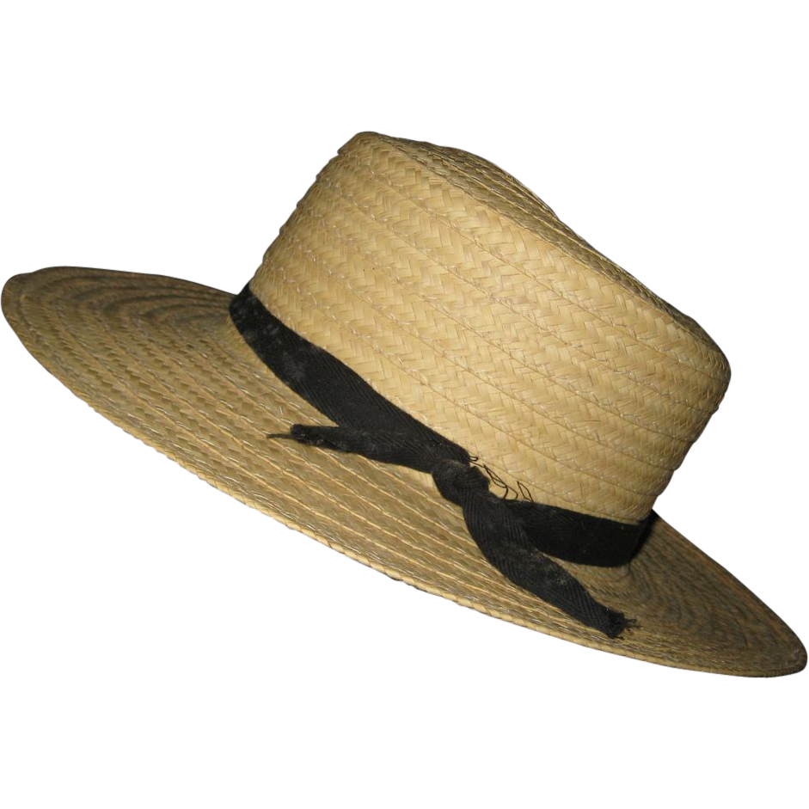
Purposes
Ecology
Humanitarian
Participatory creation of data for the public good
http://image0-rubylane.s3.amazonaws.com/shops/suzanstreasures/VCx20-x201402.1L.jpg
Notes:
OpenDroneMap originates from Computer Vision, i.e. how do we enable computers to navigate and understand the world.
It depends on stereo vision much like we do to make sense of the world in 3D

Slide 5
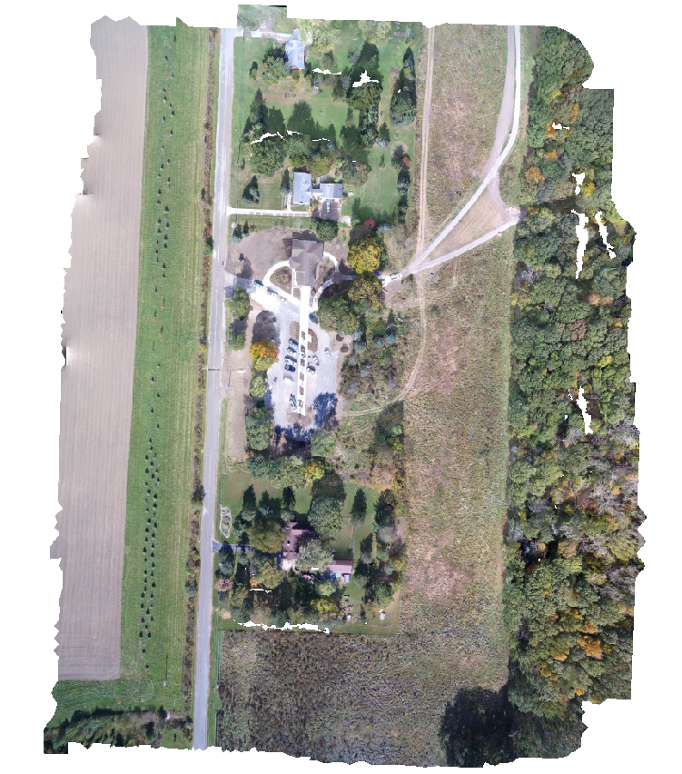
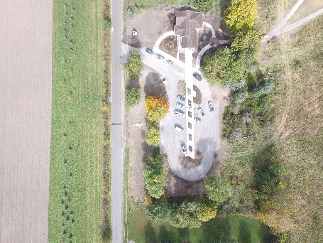
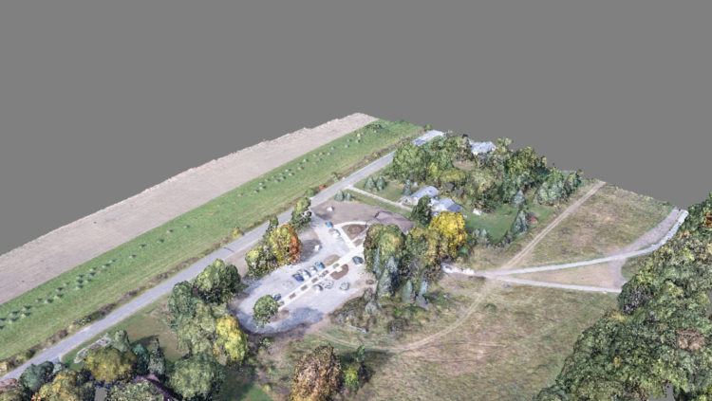
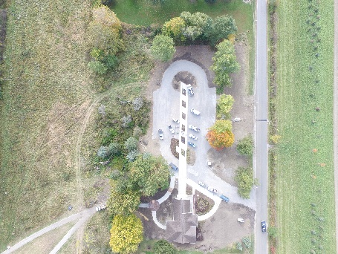
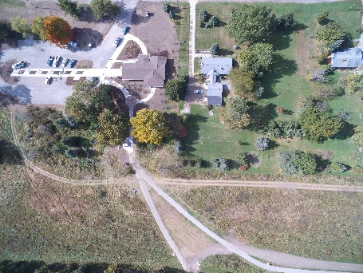
Photogrammetric Process

Slide 6
Usage
Command line tool
https://github.com/opendronemap/opendronemap
Portable OpenStreetMap (POSM)
https://github.com/posm/posm
Node-OpenDroneMap
Web API for ODM
WebODM
Multi-user (Django) environment for ODM
OpenDroneMap-ecs
https://github.com/OpenDroneMap/opendronemap-ecs

Slide 7
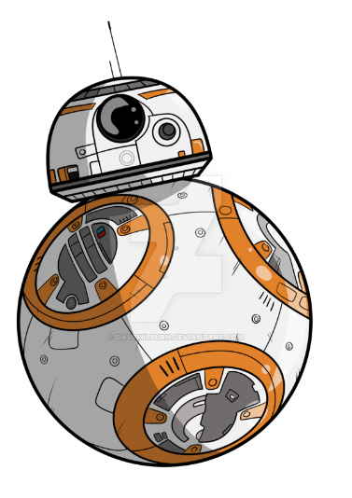
Future
Quality reporting and robustness improvements
Scalability improvements
Performance improvements
http://davemilburn.deviantart.com/art/BB8-586862785

Slide 8
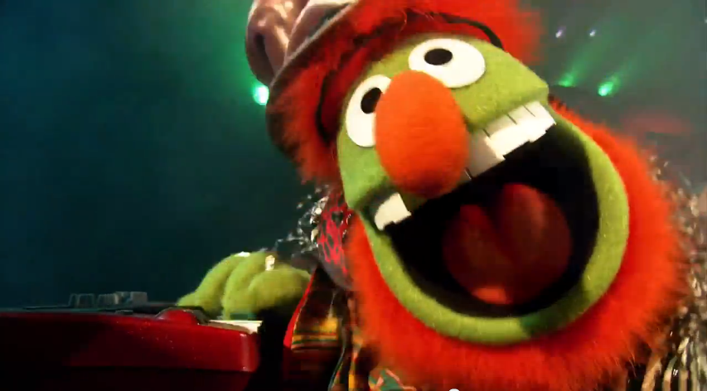
Scalability
Split large numbers of images into smaller groups
Run OpenSfM reconstruction on each subgroup
Align and transform those groups to each other using matching features between the groups

Slide 9
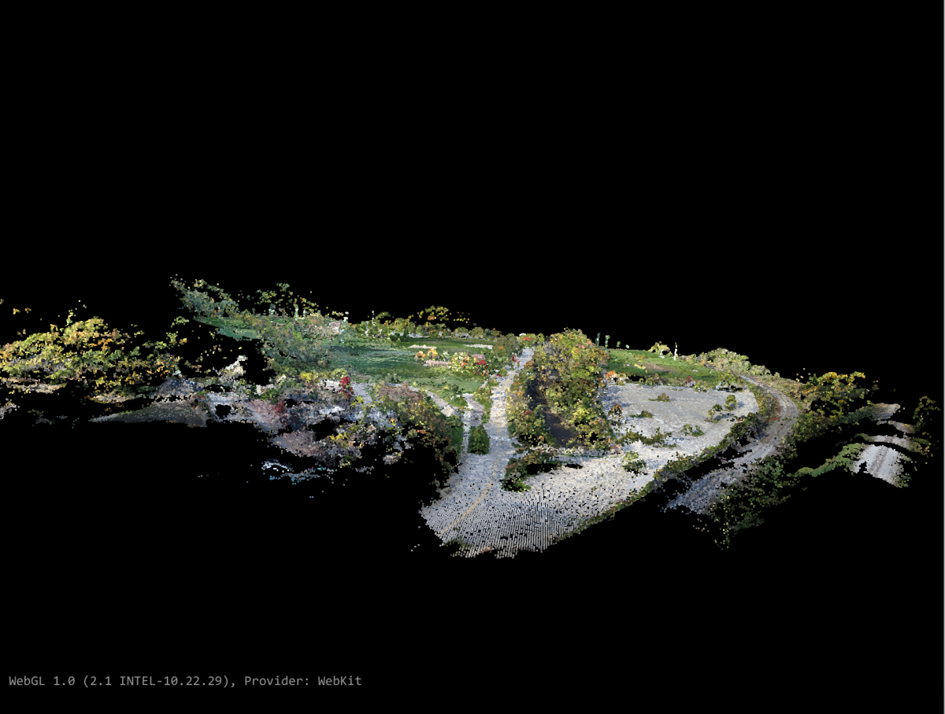
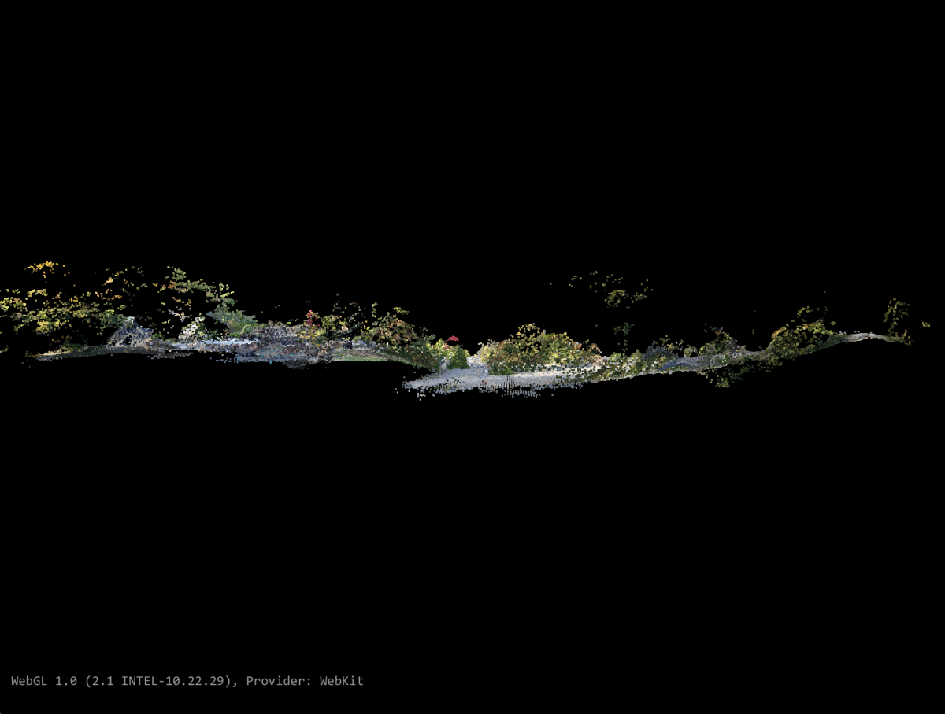
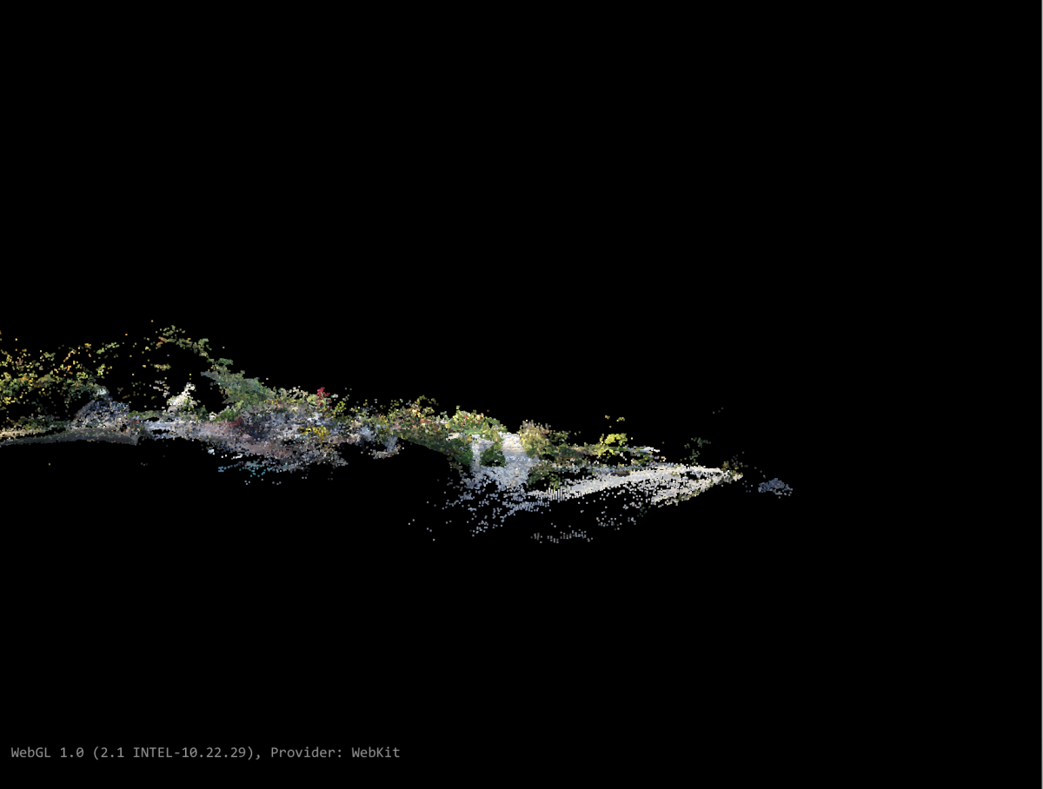
Scalability with consistency

Slide 10
Compounding Z error across large landscape

Slide 11
Corrected Z error across large landscape

Slide 12
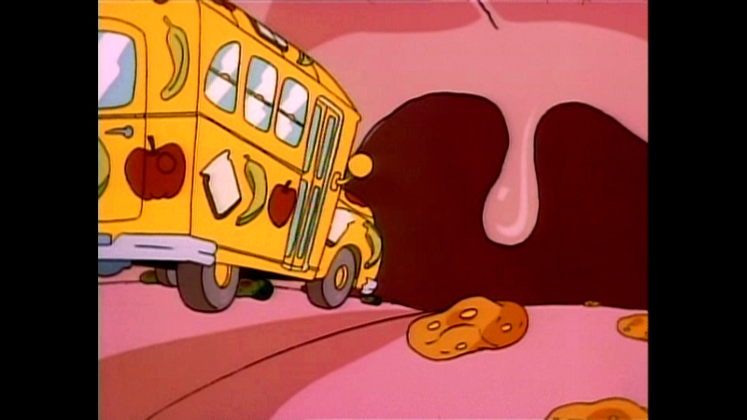
Performance improvements
Improve processor use
Cascade Hashing¹ matching
or
Bag of Words²
Improved Memory Use:
Improved correspondence graph data structures
SLAM-like pose-graph methods for global adjustment of camera position
[1] Jian Cheng, Cong Leng, Jiaxiang Wu, Hainan Cui, Hanqing Lu; The IEEE Conference on Computer Vision and Pattern Recognition (CVPR), 2014, pp. 1-8
[2] Michal Havlena, Konrad Schindler; VocMatch: Efficient Multiview Correspondence for Structure from Motion; Institute of Geodesy and Photogrammetry, ETH Zurich, Switzerland

Slide 13
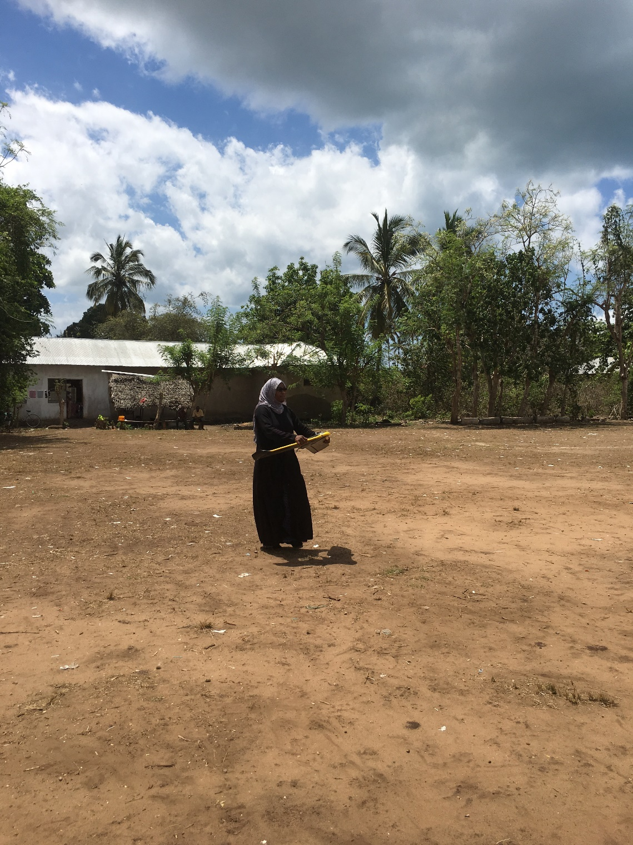
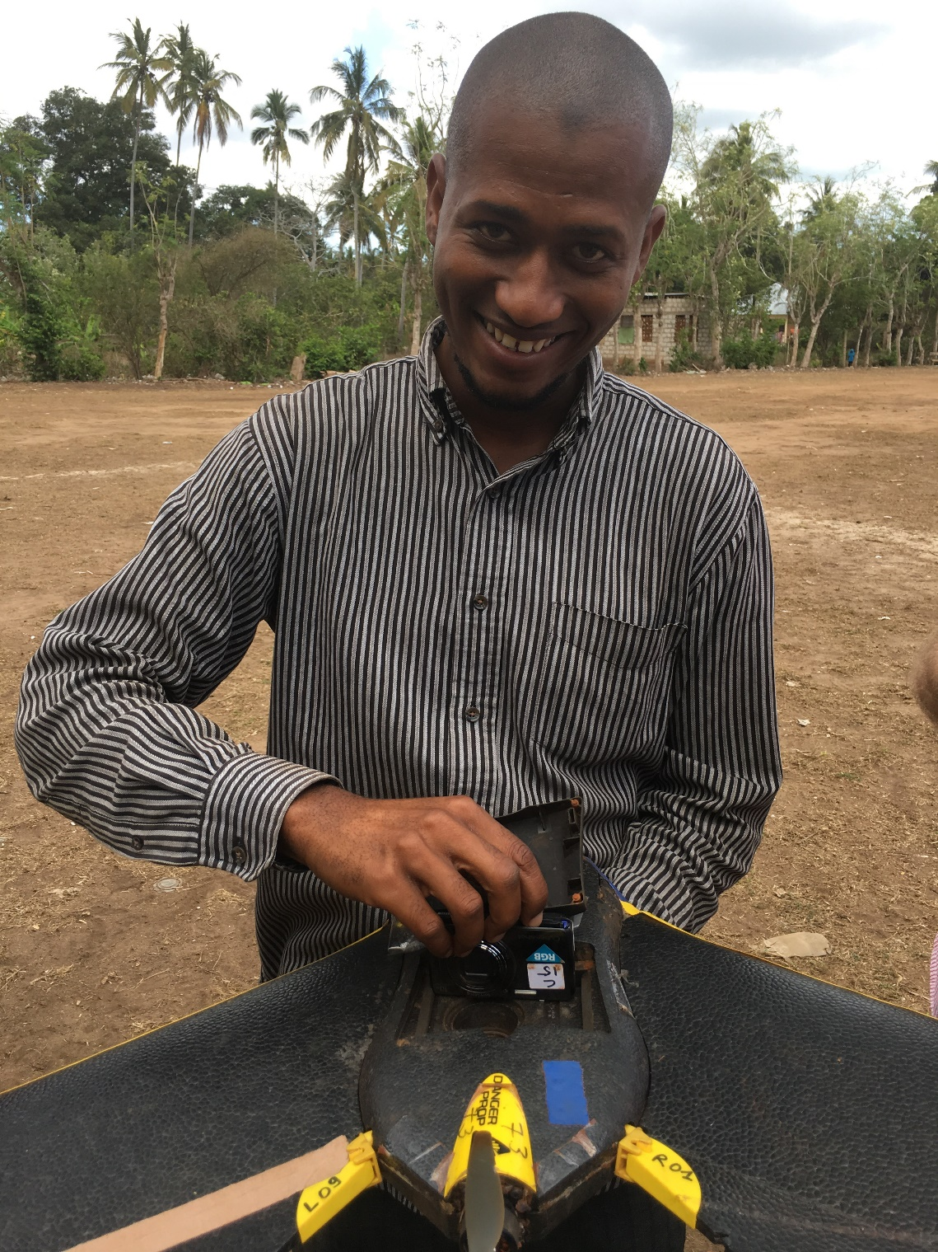

Slide 14
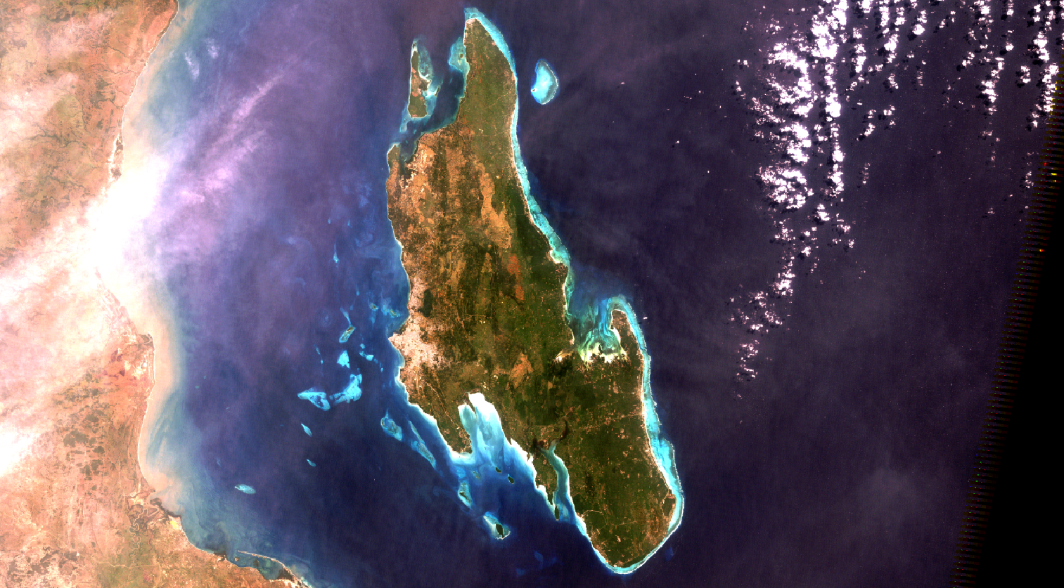

Slide 15
